Slide 1
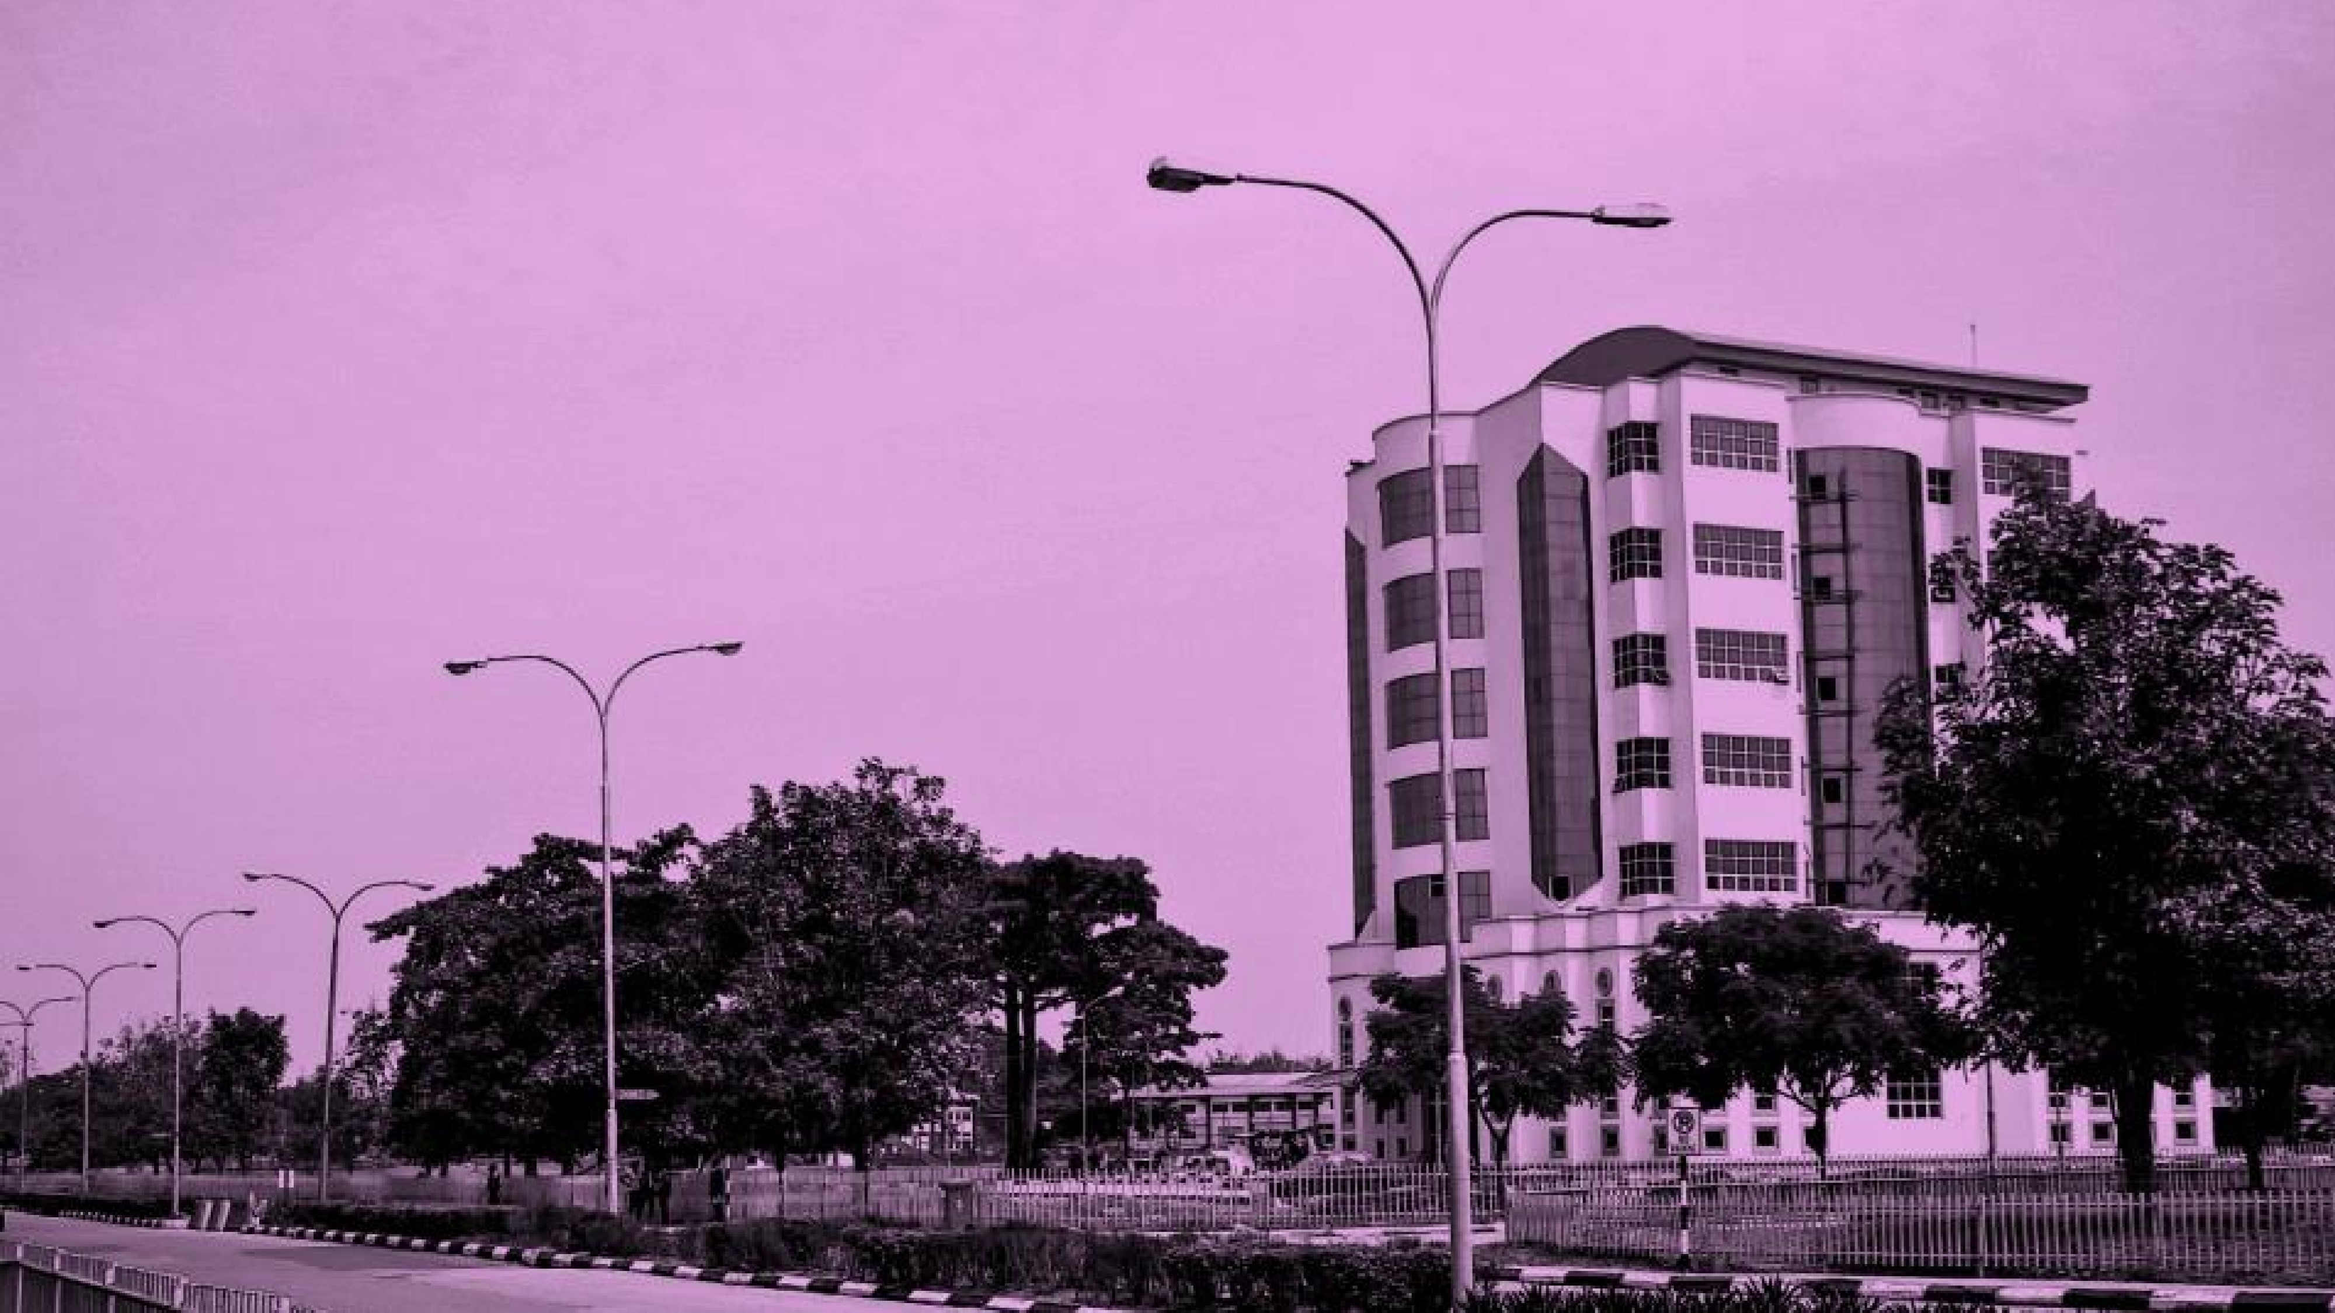


www.covenantuniversity.edu.ng
Raising a new Generation of Leaders
CSC 432 - FILE PROCESSING
LECTURE FOUR
FILE SYSTEM SECURITY

Slide 2
File Security
Risk is the possibility that an intruder may be successful in attempting to access your computer.
An intruder can read or write files, execute programs that could cause damage.
An intruder can delete critical data.
An intruder can prevent you or your company from getting important work done.
Someone gaining access to your account, or your system, can also impersonate you.

Slide 3
File Security(Cont)
Threat is typically from someone with motivation to gain unauthorized access to your computer.
You must decide whom you trust to have access to your system, and what threat they could pose.
There are several types of intruders, and it is useful to keep their different characteristics in mind as you are securing your systems.

Slide 4
File Security(Cont)
The Curious - This type of intruder is basically interested in finding out what type of system and data you have.
The Malicious - This type of intruder is out to either bring down your systems, or deface your web page, or otherwise force you to spend time and money recovering from the damage he has caused.
The High-Profile Intruder - This type of intruder is trying to use your system to gain popularity and infamy. He might use your high-profile system to advertise his abilities.

Slide 5
File Security(Cont)
The Competition - This type of intruder is interested in what data you have on your system. It might be someone who thinks you have something that could benefit him, financially or otherwise.
The Borrowers - This type of intruder is interested in setting up shop on your system and using its resources for their own purposes. He typically will run chat or irc servers, porn archive sites, or even DNS servers.
The Leapfrogger - This type of intruder is only interested in your system to use it to get into other systems. If your system is well-connected or a gateway to a number of internal hosts, you may well see this type trying to compromise your system.

Slide 6
The Security Environment
Security has many facets. Two of the more important ones relate to data loss and intrusion. Some of the common causes of data loss are:
Natural phenomenon such as: fire, flood.
Hardware or software errors: CPU malfunctions, unreadable disks or tapes, telecommunication errors, program bugs.
Human errors: incorrect data entry, wrong tape or disk mounted, wrong program run, lost disk or tape.
Most of these can be dealt with by maintaining adequate backups, preferably far away from the original data.

Slide 7
System Protection
To protect the system, we must take security measures at three levels:
Physical: The site or sites containing the computer systems must be physically secured against entry by unauthorized persons.
Human: Users must be screened carefully to reduce the chances of authorising a user who then gives access to an intruder.
Network: Computer data in modern systems travels over private leased lines, shared lines such as: the Internet, or dial-up lines. Intercepting these data could be just as harmful as breaking into a computer.

Slide 8
System Protection(Cont)
Security at the human and physical levels must be maintained if the operating-system security is to be ensured.
A weakness at a high level of security (physical or human) allows circumvention of strict low-level (operating system) security measures.
Furthermore, the system hardware must provide protection to allow the implementation of security features. Most contemporary operating systems are now designed to provide security features

Slide 9
Intrusion
Intrusion is a set of actions that attempt to compromise the integrity, confidentiality, or availability of any resource on a computing platform.
Categories of Intruders
Casual Prying. Many people have terminals linked to timesharing systems on their desks, and human nature being what it is, some of them will read other people’s electronic mails and other files if no barriers are placed in the way.
Snooping by Insiders. Students, system programmers, operators, and other technical personnel often consider it to be a personal challenge to break the security of a local computer system. They are often highly skilled and are willing to devote a substantial amount of time to the effort.

Slide 10
Intrusion(Cont)
Fraudsters. Some bank programmers have attempted banking system to steal from the bank. Schemes vary from changing software to truncating rather than rounding off interest, keeping the fraction of money for themselves, siphoning off accounts not used for years, to blackmail.
Espionage. Espionage refers to a serious and well-funded action by a competitor or a foreign country to steal programs, trade secrets, patents, technology, circuit designs, marketing plans, and so forth. Often this attempt will involve wiretapping or even erecting antennas at the computer to pick up its electromagnetic radiation.

Slide 11
Intrusion Detection and Prevention
A well-configured and properly placed intrusion detection system (IDS) or intrusion prevention system (IPS) should not be missing from the array of security controls.
IDS and IPS operates by listening passively (intrusion detection) or in-line (intrusion prevention) to network traffic and matching this traffic to a rule set covering suspicious and malicious traffic signatures.
An intrusion detection system can alert a user when a match occurs; an intrusion prevention system can also block the traffic, hence the P, for prevention.

Slide 12
Intrusion Detection
Intrusion detection strives to detect attempted or successful intrusions into computer systems and to initiate appropriate responses to the intrusions. Intrusion detection encompasses a wide array of techniques that vary on a number of issues. These issues include:
Time of detection. Detection can occur in real time (while the intrusion is occurring) or after.
Response Capabilities. Simple forms of response include alerting an administrator to the potential intrusion or somehow halting the potentially intrusive activity by stopping a process engaged in the intrusive activity.

Slide 13
Intrusion Detection (Cont)
Auditing and Logging. A common method of intrusion detection is audit-trail processing, in which security-relevant events are logged to an audit trail and then matched against attack signatures (in signature-based detection) or analyzed for anomalous behavior (in anomaly detection).
Tripwire operates on the premise that many intrusions result in anomalous modification of system directories and files.
System-Call Monitoring This approach monitors process system calls to detect in real time when a process is deviating from its expected system-call behaviour.

Slide 14
Security Threats
Threat occurs when a program written by one user may be used by another, misuse and unexpected behaviour may result. Some common methods by which users gain access to the programs of others are:
Trojan horses
Trap doors
Stack and buffer overflow.

Slide 15
Security Threats(Cont)
Trojan Horse
A code segment that misuses its environment is called a Trojan Horse. It is a type of malware that is often disguised as a legitimate software. Users are tricked by some form of social engineering (e-mail) into executing Trojans on their system. Once activated it can:
Delete data
Block data
Modify
Copy data
Disrupt the performance of computers.

Slide 16
Security Threats(Cont)
Trap Door
The designer of a program or system might leave a ‘door’ in the software that only he/she is capable of using.
Also known as backdoor, provides a legitimate means of gaining access to an application or OS for testing or debugging. This type of security breach is called trap door.
Illegal persons (Programmers) have been arrested for embezzling from banks by including rounding errors in their code and having the occasional half-cent credited to their accounts.
This account crediting can add up to a large amount of money, considering the number of transactions that a large bank executes.

Slide 17
Security Threats(Cont)
Trap Door(Cont)
Malware can install trapdoors leading to all kinds of malicious attacks
Trap doors pose a difficult problem because, to detect them, we have to analyze all the source code for all components of a system.
Given that software systems may consist of millions of lines of code, this analysis is not done frequently, and frequently it is not done at all!

Slide 18
Security Threats (Cont)
Stack and Buffer Overflow
While writing data to a buffer, its possible to overrun the boundary and write into adjacent memory locations.
Its possible to maliciously cause buffer overflow to write into a place that holds executable codes.
This could lead to erratic program behaviour and crashes.

Slide 19
Security Threats (Cont)
Stack and Buffer Overflow(Cont)
This is the most common way for an attacker outside of the system, on a network or dial-up connection, to gain unauthorized access to the target system.
An authorized user of the system may also exploit this for privilege escalation, to gain privileges beyond those allowed for that user.

Slide 20
Security Threats (Cont)
Stack and Buffer Overflow
The bug can be a simple case of poor programming, in which the programmer neglected to code bounds checking on an input field.
The buffer-overflow attack is especially fatal, as it can be run within a system and can travel over allowed communications channels.
Such attacks can occur within protocols that are expected to be used to communicate with the machine, and they can therefore be hard to detect and prevent.
They can even bypass the security added by firewalls. One solution to this problem is for the CPU to have a feature that disallows execution of code in a stack section of memory.

Slide 21
Security Threats (Cont)
Worms
A worm is a process that uses the spawn mechanism to ravage system performance.
The worm spawns copies of itself, using up system resources and perhaps locking out all other processes.
On computer networks, worms are particularly potent, since they may reproduce themselves among systems and thus shut down the entire network.

Slide 22
Security Threats (Cont)
Virus
A computer virus is a self-replicating software that infects computer programs by modifying them thereby causing the system to malfunction.
Like worms, viruses are designed to spread into other programmes and can wreck havoc in a system by modifying or destroying files and causing system crashes and programme malfunctions.
Whereas a worm is structured as a complete, standalone programme, a virus is a fragment of code embedded in a legitimate programme.

Slide 23
Security Threats (Cont)
Virus
Viruses are a major problem for computer users, especially users of microcomputer systems.
Multiuser computers generally are not susceptible to viruses because the executable programs are protected from writing by the operating system.
Even if a virus does infect a programme, its powers are limited because other aspects of the system are protected.

Slide 24
Security Threats (Cont)
Virus(Cont)
Single-user systems have no such protections and, as a result, a virus has free run.
Viruses are usually spread when users download viral programmes from public bulletin boards or exchange disks containing an infection.

Slide 25
Security Threats (Cont)
Virus(Cont)
In recent years, a common form of virus transmission has been via the exchange of Microsoft Office files, such as Microsoft Word documents.
These documents can contain so-called macros (or Visual Basic Programmes) that programmes in the Office suite (Word, PowerPoint, or Excel) will execute automatically.

Slide 26
Security Threats (Cont)
Virus(Cont)
A recent development to computer virus software is the Ransomware.
Ransomware is a type of malicious software that carries out cryptoviral extortion attack from cryptovirology that blocks access to data until a ransom is paid and displays a message requesting payment to unlock it.
Ransomware attacks are typically carried out using Trojan that has a payload disguised as a legitimate file.

Slide 27
Security Threats (Cont)
Virus(Cont)
The implementation is a 3-round protocol carried out between the attack and the victim.
Attacker → Victim. The attacker generates a key pair and places the corresponding public key in the malware. The malware is released.
Victim → Attacker. To carry out the cryptoviral extortion attack, the malware generates a random symmetric key and encrypts the victim's data with it. It uses the public key in the malware to encrypt the symmetric key.

Slide 28
Security Threats (Cont)
Virus(Cont)
This is known as hybrid encryption and it results in a small asymmetric ciphertext as well as the symmetric ciphertext of the victim's data.
It zeroizes the symmetric key and the original plaintext data to prevent recovery.
It puts up a message to the user that includes the asymmetric ciphertext and how to pay the ransom. The victim sends the asymmetric ciphertext and e-money to the attacker.

Slide 29
Security Threats (Cont)
Virus(Cont)
Attacker → Victim. The attacker receives the payment, deciphers the asymmetric ciphertext with the attacker's private key, and sends the symmetric key to the victim.
The victim deciphers the encrypted data with the needed symmetric key thereby completing the cryptovirology attack.

Slide 30
Security Threats (Cont)
Most commercial antivirus packages are effective against only particular known viruses.
They work by searching all the programmes on a system for the specific pattern of instructions known to make up the virus.
When they find a known pattern, they remove the instructions, disinfecting the programme. These commercial packages have catalogs of thousands of viruses for which they search.

Slide 31
Security Threats (Cont)
Viruses and the antivirus software continue to become more sophisticated.
Some viruses modify themselves as they infect other software to avoid the basic pattern-match approach of antivirus software.
The antivirus software in turn now looks for families of patterns rather than a single pattern to identify a virus.

Slide 32
Security Threats (Cont)
The best protection against computer viruses is prevention, or the practice of safe computing.
Purchasing unopened software from vendors and avoiding free or pirated copies from public sources or disk exchange is the safest route to preventing infection.
For macro viruses, one defense is to exchange Word documents in an alternative file format called rich text format (RTF). Unlike the native Word format, RTF does not include the capability to attach macros.
Another defense is to avoid opening any e-mail attachments from unknown users.
Back up your data to avoid critical loss in the eventuality of an attack.

Slide 33
Security Threats (Cont)
Denial of Service
The last attack category, denial of service, is aimed not at gaining information or stealing resources but rather at disrupting legitimate use of a system or facility.
An intruder could delete all the files on a system, for example. Most denial-of-service attacks involve systems that the attacker has not penetrated.
Indeed, launching an attack that prevents legitimate use is frequently easier than breaking into a machine or facility.

Slide 34
Security Solutions
User Authentication
A major security problem for operating systems is authentication.
The protection system depends on the ability to identify the programs and processes currently executing, which in turn depends on the ability to identify each user of the system.
The process of identifying users when they log on is called user authentication.

Slide 35
Security Solutions
User Authentication(Cont)
How do we determine whether a user's identity is authentic? Generally, authentication is based on one or more of three items:
User possession (a key or card).
User knowledge (a user identifier and password)
User attributes (fingerprint, retina pattern, or signature).

Slide 36
Security Solutions(Cont)
Passwords
The most common approach to authenticating a user identity is the use of passwords.
When a user identifies herself by user ID or account name, a password required.
If the user-supplied password matches the password stored in the system, the system assumes that the user is legitimate. Passwords are often used to protect objects in the computer system, in the absence of more complete protection schemes.
Different passwords may be associated with different access rights. For example, different passwords may be used for reading files, appending files, and updating files.

Slide 37
Security Solutions (Cont)
Password Vulnerabilities
Passwords are extremely common because they are easy to understand and use. Unfortunately, passwords can often be guessed, accidentally exposed, sniffed, or illegally transferred from an authorized user to an unauthorised one.
There are two common ways to guess a password:
One way is for the intruder (either human or program) to know the user or to have information about the user.
The use of brute force, trying enumeration, or all possible combinations of
letters, numbers, and punctuation, until the password is found.

Slide 38
Security Solutions (Cont)
In addition to being guessed, passwords can be exposed as a result of visual or electronic monitoring.
An intruder can look over the shoulder of a user (shoulder surfing) when the user is logging in and can learn the password easily by watching the keystrokes.
Some systems force users to select hard-to-remember or long passwords, which may cause a user to record the password. As a result, such systems provide much less security than systems that allow easy passwords!
Alternatively, anyone with access to the network on which a computer resides could seamlessly add a network monitor, allowing her to watch all data being transferred on the network (sniffing), including user IDs and passwords.
Encrypting the data stream containing the password solves this problem. Exposure is a particularly severe problem if the password is written down where it can be read or lost.

Slide 39
Security Solutions (Cont)
Biometrics
There are many other variations to the use of passwords for authentication.
Hand-readers are commonly used to secure physical access—for example, access to a data center. These readers match stored parameters against what is being read from hand-reader pads.
The parameters can include a temperature map, as well as finger length, finger width, and line patterns. These devices are currently too large and expensive to be used for normal computer authentication.

Slide 40
Security Solutions (Cont)
Fingerprint readers have become accurate and cost-effective and should become more common in the future.
These devices read your finger's ridge patterns and convert them into a sequence of numbers.
Over time, they can store a set of sequences to adjust for the location of the finger on the reading pad and other factors.
Software can then scan a finger on the pad and compare its features with these stored sequences to determine if the finger on the pad is the same as the stored one.

Slide 41
Security Solutions (Cont)
Of course, multiple users can have profiles stored, and the scanner can differentiate among them.
A very accurate two-factor authentication scheme can result from requiring a password as well as a user name and fingerprint scan.
If this information is encrypted in transit, the system can be very resistant to spoofing or replay attack.

Slide 42
File Protection (Cont)
There are two most popular implementations of file protection:
File Naming
It depends upon the inability of a user to access a file he cannot name.
This can be implemented by allowing only users to see the files they have created.
But since most file systems allow only a limited number of characters for filenames, there is no guarantee that two users will not use the same filenames.

Slide 43
File Protection (Cont)
Password Protection
This scheme associates a password to each file.
If a user does not know the password associated to a file then he cannot access it.
This is a very effective way of protecting files but for a user who owns many files, and constantly changes the password to make sure that nobody accesses these files will require that users have some systematic way of keeping track of their passwords.

Slide 44
Test One – Next Week

